Slide 1
MTSS-Direct Student Services
EIP/ Remedial, 504 Plans, SEL, Behavior, ESOL*

Slide 2
K-2 Assistant Principal-
Director of Student Services is to support K-6 students in MTSS to monitor student achievement and achievement. I work with teachers and the coordinators to support student performance.
EIP Interventions
504 Plans
Remedial
Resource Instruction
SEL Learning
K-2 Assistant Principal &
Director of Student Services cle@yhale.org

Slide 3
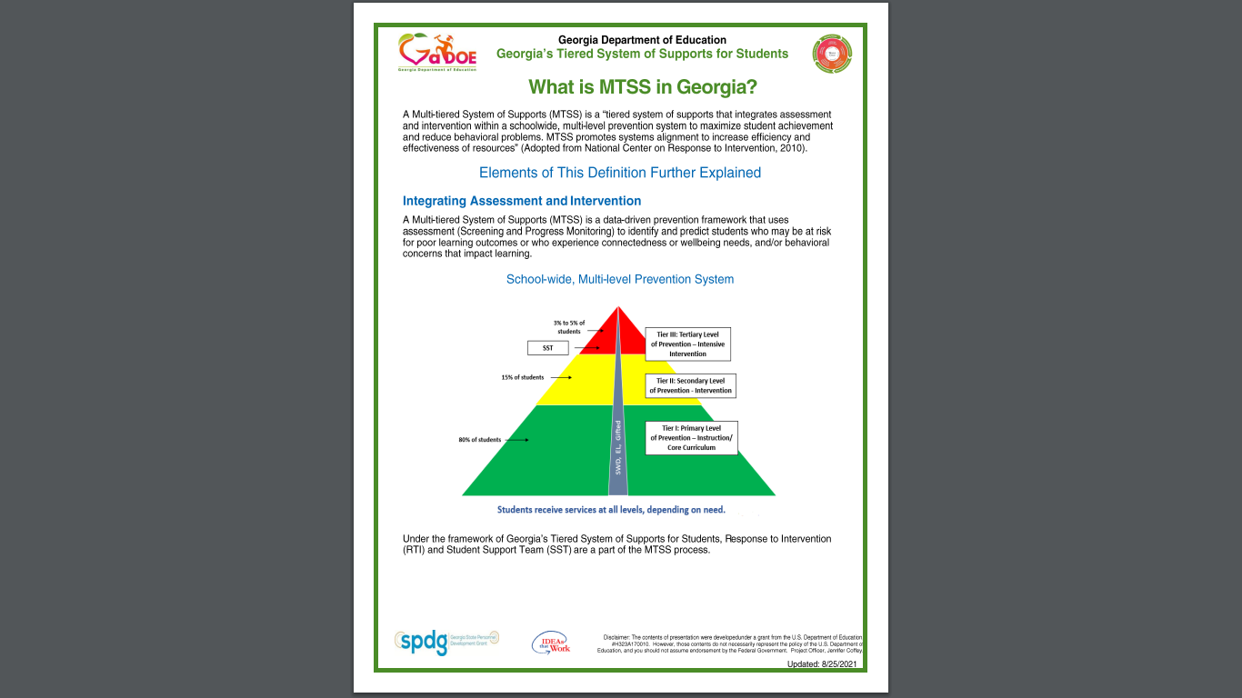

Slide 4
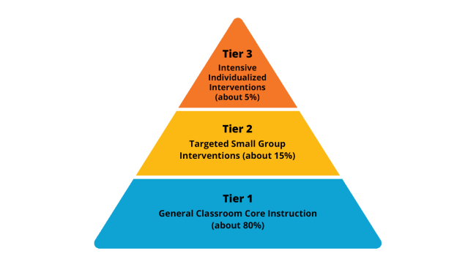

Slide 6
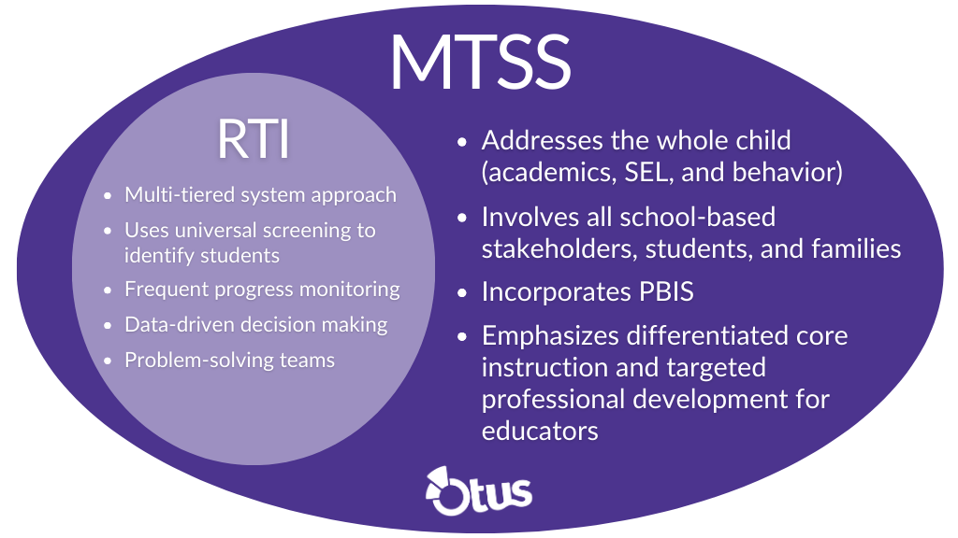

Slide 8
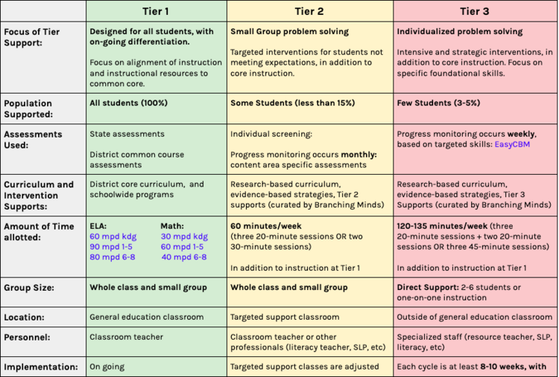

Slide 9
EIP Resource Instruction
State of Georgia Early Intervention Program (EIP K-5) Remedial 6-8th grade Milestones/ MAP ..etc
Must qualify - EIP Rubric Scale (K-5)
MAP Scores*/ Milestones
Reading levels
Performance in math
classroom observations.
Monitored in Tier 2 or Tier 3.
Set Interventions
Students who do not qualify for EIP that made need additional support
Based on MAP Data
Based of Reading/ Math observation/grades
Teacher recommended
Set Interventions based on individual needs
Monitored in MTSS Tier 2 or Tier 3

Slide 10
What is a 504 plan?
Section 504 of the Rehabilitation Act outlaws discrimination against people with disabilities in facilities that get federal funds-- like public schools.
504 plans are plans that schools make to give kids with disabilities such as, anxiety and the services and support they need to learn alongside their peers.
504 plans is not SPED, but if needed supports Individualized Education Programs (IEPs). They both can be used to help students with disabilities access education. IEPs are under a different law, the Individuals with Disabilities Education Act (IDEA). 504 plans and IEPs are two different ways to provide services and support to kids with disabilities.

Slide 12
Examples of reasonable 504 accommodations are:
tests read out loud for children with dyslexia or blindness,
an enlarger for a child with low vision;
less written homework for children with disabilities affecting writing,
a behavior management plan for a child with a behavior disorder, or
an accessible restroom for a child who uses a wheelchair.
small group testing for Milestones/MAP
Speech to text

Slide 13
Supporting SEL Learning at home and School
Principal Talk- Students join for bi-monthly meeting to learning about topics SEL Topics.
Building Friendships
Bullying
Kindness and Respect
Empathy and Caring
School work and routines
Conflict resolution/self-control
Proactive Choices and decisions
Morning meetings with Teachers*

Slide 14
What is Social Emotional Learning(SEL)
Social-emotional learning (SEL) is the process of developing the self-awareness, self-control, and interpersonal skills that are vital for school, work, and life success.
People with strong social-emotional skills are better able to cope with everyday challenges and benefit academically, professionally, and socially. From effective problem-solving to self-discipline, from impulse control to emotion management and more, SEL provides a foundation for positive, long-term effects on kids, adults, and communities.

Slide 15
How can I increase my child’s learning?
How can I help my child at home?
Starfall.com
RAZ Kids
Practice IXL at home
Math Playground
Memorize sight words ( Dolch or Fry words)
Word families
Ask comprehension questions before, during, and after reading

