Slide 1

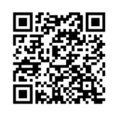

Title 1 Annual Meeting
Topic: Title 1 Annual Meeting
Time: Sep 17, 2024 06:30 PM Eastern Time (US and Canada)
Join Zoom Meeting
https://us06web.zoom.us/j/2300636271?pwd=HhpH6eb4LjVTSlpOXqTgWWstCY5t4b.1&omn=81374465810
Meeting ID: 230 063 6271
Passcode: gxkU0L
Scan to Join
Review Compact Here

